Slide 1


API-first! Contract-first! Make API development great again!
Atanas L. Kuzmanov
Senior Software Engineer
Notes:
Hi everyone and welcome to my talk about API testing, validation, contracts and API development.

Slide 2
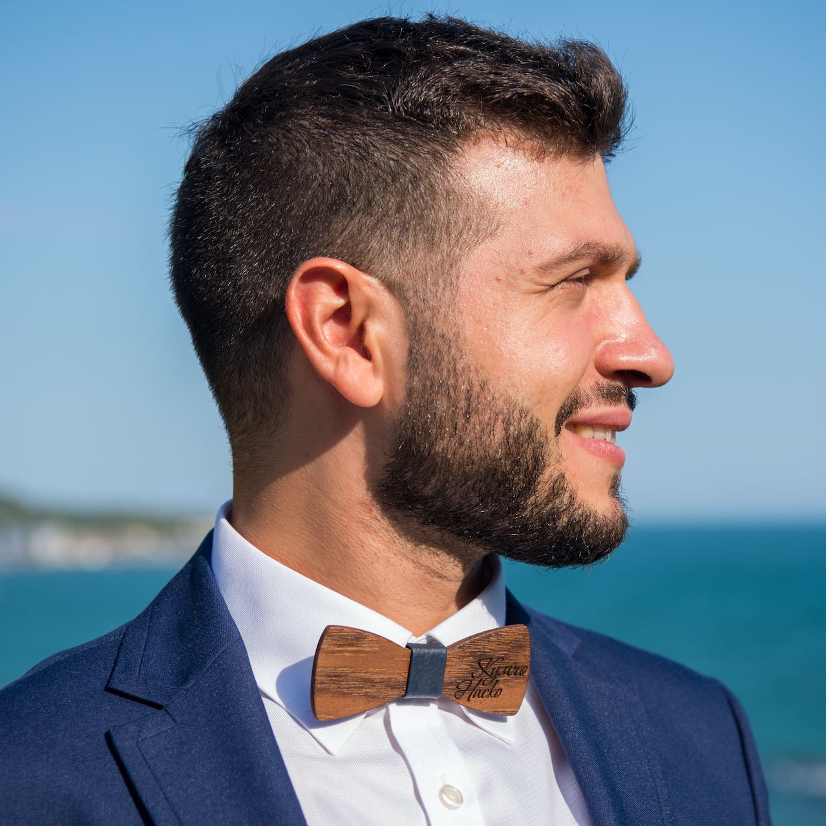
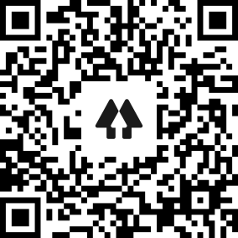




Hello, my name is
Atanas L. Kuzmanov
Senior Software Engineer
IT Solution Development
SchwarzIT Bulgaria
Background:
Where do you work?
What do you do there?
Why are you talking about this topic?
Why are you giving this talk today?
About me:
{
}
https://github.com/atkuzmanov
https://www.linkedin.com/in/atkuzmanov/
https://twitter.com/atkuzmanov
https://linktr.ee/atkuzmanov https://atkuzmanov.wordpress.com/
Currently:
Previously:
Notes:
Hi, my name is Atanas
I am a Senior Software Engineer at SchwarzIT Bulgaria
Here is a bit of background about me
- Where do you work?
IT Solution Development Department at Schwarz IT Bulgaria.
- What do you do there?
I am part of the team which develops and maintains our property management CMS systems, and more.
- Why are you talking about this topic?
I was given a task which I finished quicker than expected and I was crying out for work.
My colleagues gave me a new task, I guess as a bit of a challenge or a bit of a joke – me being unaware it being something they were unable to solve a couple of years ago.
And for a good reason, the technology isn’t quite there yet, but after a lot of hard work I was able to solve it.
- Why are you giving this talk today?
At the time, to the best of my knowledge, it’s only us at Schwarz and very few other companies, using this tech in this particular way. It's only in the past couple of months that I have seen the trend of more companies adopting this.
Very few of them are talking about this, and there are almost no blog posts or tutorials. So, I want to share my findings with you as I think they are immediately applicable in practice and greatly beneficial.

Slide 3


Agenda

Slide 4
INTRODUCTION

Slide 6
SIDE NOTE

Slide 7
API

Slide 8
API

Slide 9
API CONTRACT
asdasda

Slide 10
DESIGN FIRST VS. CODE FIRST

Slide 11
WOLF FACT
asdasd

Slide 12
CLOSING THOUGHTS
asdasd
asdasd

Slide 13
THANK YOU

